Slide 1
Indexing

Slide 2
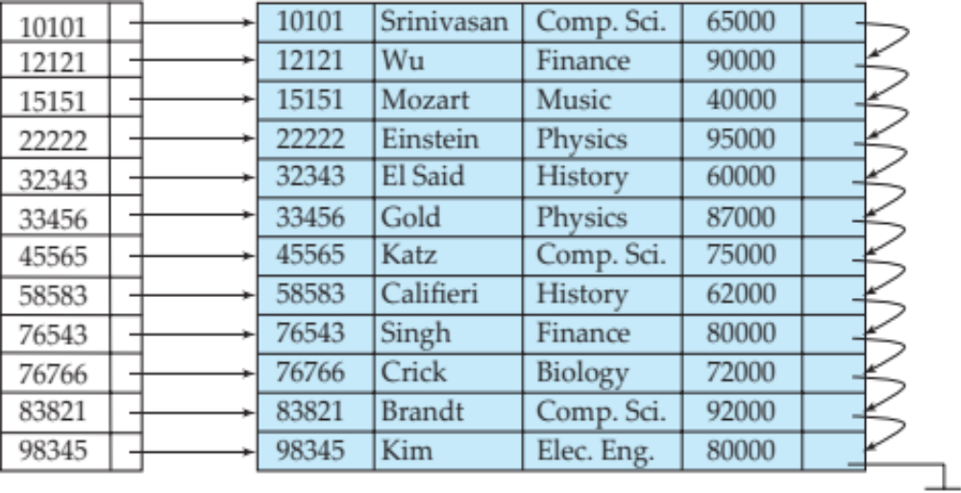
Basic Concepts
Indexing mechanisms used to speed up access to desired data.
Q1- Select * from instructor where id = 76766
Instructor relation and an index of instructor relation on id is given. Each record is stored in one block. How can the above query be executed
Without index (linear file scan)?
With using index?
Index
Question: index is kept in memory.
Explain best case and worst case of processing this query using linear scan.
In which case, this query will be faster using index?

Slide 3
Basic Concepts
Search Key - attribute or set of attributes used to look up records in a file.
Index on Id, search key is Id
Index on name, search key is name
Index on dept-name, search key is dept-name
Index

Slide 4
Basic Concepts
An index file consists of records (called index entries) of the form
search-key
pointer
Index

Slide 5

Basic Concepts
Index files are typically much smaller than the original file
Two basic kinds of indices:
  Ordered indices: search keys are stored in sorted order
  Hash indices: search keys are distributed uniformly across “buckets” using a “hash function”.
Index

Slide 6
Index Evaluation Metrics
Access types supported efficiently. E.g.,
  records with a specified value in the attribute e.g., Select * from instructor where id = 76766 (Point query)
  or records with an attribute value falling in a specified range of values. Select * from instructor where id >= 76766 (Range query)
Access time: Time to access a corresponding record for the given query
Insertion time: Time to insert a record into the relation including index entries
Deletion time: Time to delete a record from the relation including index deletions
Space overhead: Storage space needed for the index

Slide 7

Ordered Indices
In an ordered index, index entries are stored sorted on the search key value.
Primary index: in a sequentially ordered file, the index whose search key specifies the sequential order of the file.
  Also called clustering index
  The search key of a primary index is usually but not necessarily the primary key.
Index

Slide 8
Dense Index Files
Dense index — Index record appears for every search-key value in the file.
E.g. index on ID attribute of instructor relation

Slide 9
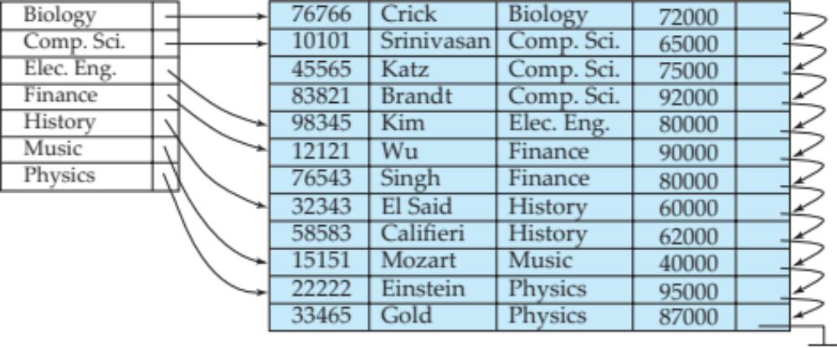
Dense Index Files (Cont.)
Dense index on dept_name, with instructor file sorted on dept_name

Slide 10
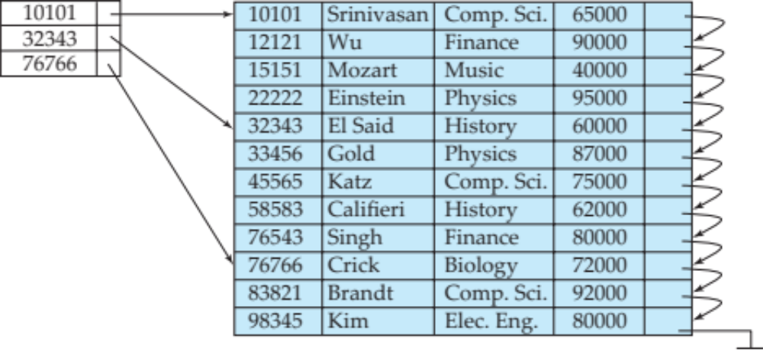
Sparse Index Files
Sparse Index: contains index records for only some search-key values.
  Applicable when records are sequentially ordered on search-key
To locate a record with search-key value K we:
  Find index record with largest search-key value < K
  Search file sequentially starting at the record to which the index record points
Question:
Explain how the following query will be executed using the given sparse index.
SELECT * FROM instructor WHERE id = 45565
Give a comparison between dense and sparse index

Slide 11

Sparse Index Files (Cont.)
Compared to dense indices:
  Less space and less maintenance overhead for insertions and deletions.
Example: insert into instructor values (12120, ‘Rafique’, ‘Physics’, 60000);
  Generally slower than dense index for locating records.
Example: SELECT * FROM instructor WHERE id = 76543

Slide 12
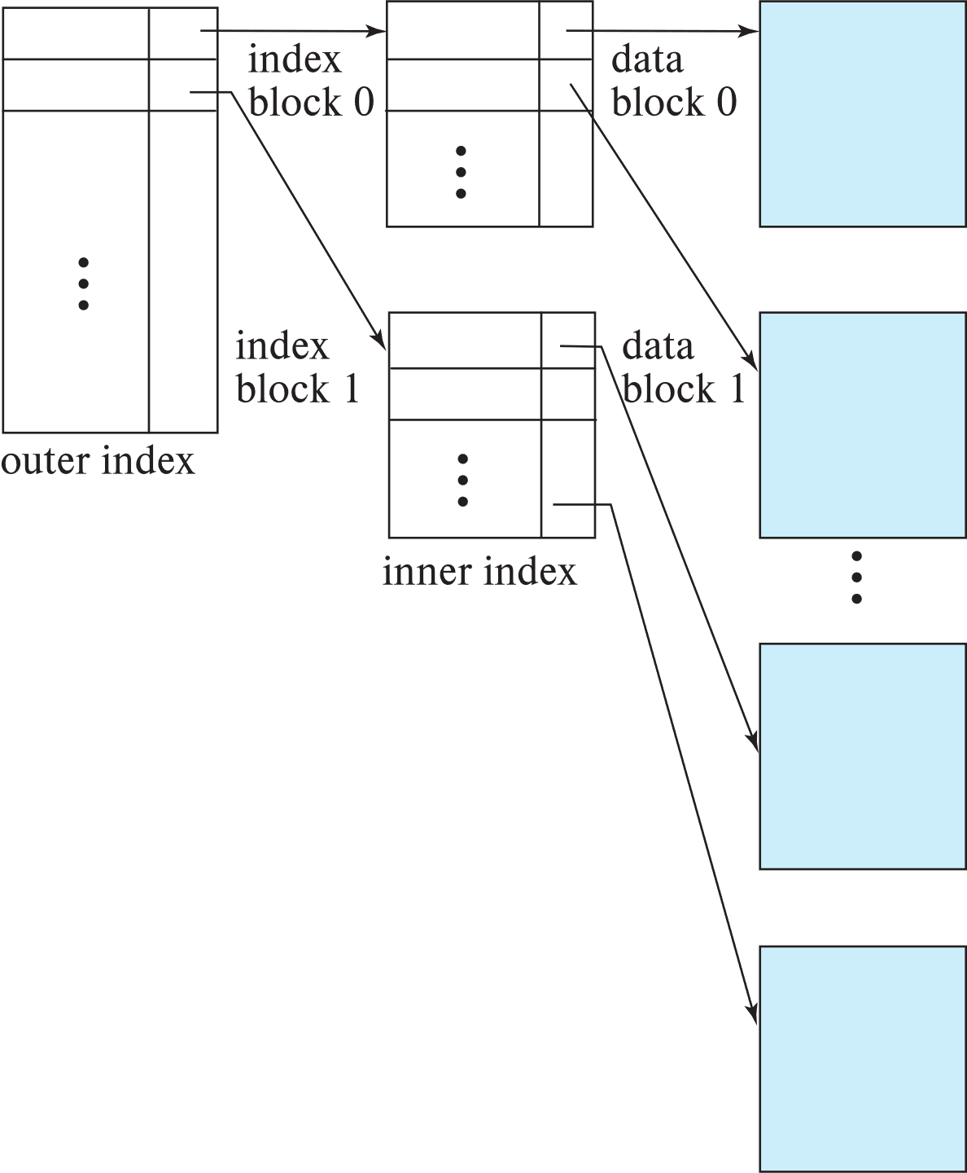

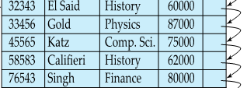
Sparse Index Files (Cont.)
Compared to dense indices:
  Less space and less maintenance overhead for insertions and deletions.
  Generally slower than dense index for locating records.
Good tradeoff:
  for clustered index: sparse index with an index entry for every block in file, corresponding to least search-key value in the block.
  For unclustered index: sparse index on top of dense index (multilevel index)

Slide 13

Secondary Indices
Secondary index: an index whose search key specifies an order different from the sequential order of the file. Also called
non-clustering index.
Index record points to a bucket that contains pointers to all the actual records with that particular search-key value.
Id name dept-name salary
Question: The primary index is given on id.
How many secondary index can be created for this relation?
Construct secondary index on dept-name. (Show only id and dept-name for the table)

Slide 14
Clustering vs Nonclustering Indices
Indices offer substantial benefits when searching for records.
BUT: indices imposes overhead on database modification
when a record is inserted or deleted, every index on the relation must be updated (Explain?)
Insert into instructor values (22225, ‘David’, ‘History’, 70000);
When a record is updated, any index on an updated attribute must be updated (Explain?)
Update instructor set salary = 50000 where id = 15151

Slide 15

Clustering vs Nonclustering Indices
Sequential scan using clustering index is efficient, but a sequential scan using a secondary (nonclustering) index is expensive on magnetic disk (Explain?)
Select * from instructor where salary <= 90000
  Each record access may fetch a new block from disk
  Each block fetch on magnetic disk requires about 5 to 10 milliseconds

Slide 16

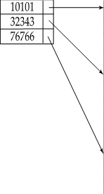
Multilevel Index
If index does not fit in memory, access becomes expensive. (Explain?)
Solution: treat index kept on disk as a sequential file (Index on id) and construct a sparse index on it.
  outer index – a sparse index of the basic index
  inner index – the basic index file
If even outer index is too large to fit in main memory, yet another level of index can be created, and so on.
Indices at all levels must be updated on insertion or deletion from the file.

Slide 17
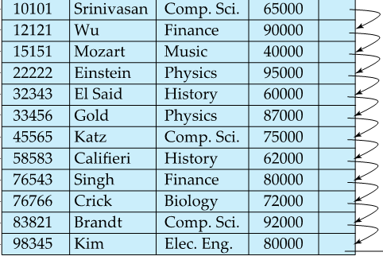
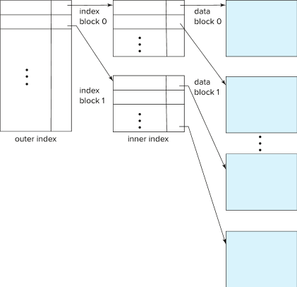



Two level sparse index
10101
10101
83821
22222
83821

Slide 18
Index Update: Deletion
If deleted record was the only record in the file with its particular search-key value, the search-key is deleted from the index also.
Single-level index entry deletion:
  Dense indices – deletion of search-key is similar to file record deletion.
  Delete from instructor where id = 22222
  Question: Write the algorithm for deletion in dense index

Slide 19

Index Update: Deletion
If deleted record was the only record in the file with its particular search-key value, the search-key is deleted from the index also.
Single-level index entry deletion:
  Sparse indices –
    if an entry for the search key exists in the index, it is deleted by replacing the entry in the index with the next search-key value in the file (in search-key order).
    If the next search-key value already has an index entry, the entry is deleted instead of being replaced.
  Delete from instructor where id = 22222
  Question: Write the algorithm for deletion in sparse index

Slide 20
Index Update: Insertion
Single-level index insertion:
  Perform a lookup using the search-key value of the record to be inserted.
  Dense indices – if the search-key value does not appear in the index, insert it
    Indices are maintained as sequential files
    Need to create space for new entry, overflow blocks may be required
Insert into instructor values (45566, ‘Karim’, ‘Physics’, 70000)
Question Write the insertion algorithm for single level sparse and dense indices

Slide 21
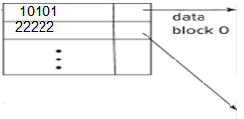
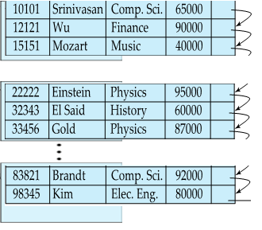

Index Update: Insertion
83821
Single-level index insertion:
  Perform a lookup using the search-key value of the record to be inserted.
  Sparse indices – if index stores an entry for each block of the file, no change needs to be made to the index unless a new block is created.
    If a new block is created, the first search-key value appearing in the new block is inserted into the index.
Assume 3 records per block.
Insert into instructor values (98400, ‘Abid’, ‘History’, 50000) * No need to add new block
Insert into instructor values (32400, ‘Atika’, ‘Comp. Sci’, 80000) * Need to add new block
Question: Write the insertion algorithm for single level sparse index

Slide 22
Index Update: Insertion
10101
22222
83821
Multilevel insertion and deletion: algorithms are simple extensions of the single-level algorithms
Assume 3 records per block.
Insert into instructor values (98400, ‘Abid’, ‘History’, 50000)
Insert into instructor values (32400, ‘Atika’, ‘Comp. Sci’, 80000)
Question Write the deletion/ insertion algorithms for multi level index with an example of 4 levels for NID database with 160 million records. Block size is 16KB and each block may contain 16 NID records and 800 index records.

Slide 23


Indices on Multiple Keys
Composite search key
  E.g., index on instructor relation on attributes (name, ID)
  Values are sorted lexicographically
    E.g. (John, 12121) < (John, 13514) and
    (John, 13514) < (Peter, 11223)
  Can query on just name, or on (name, ID)
Composite index (name, dept-name) search keys
SELECT *
FROM instructor
WHERE name = ‘Gold’ AND dept-name = ‘Physics’
Question:
There are 460 thanas and 64 districts.
Find the number of search keys of (than, district) composite index and thana simple index.
Query: select * from person where thana = ‘Sadar’ and district = ‘Sylhet’
Compare query performance using composite index and simple index

Slide 24
B⁺-Tree Index Files
Disadvantage of indexed-sequential files
  Performance degrades as file grows, since many overflow blocks get created (How?).
  Periodic reorganization of entire file is required.
10101
22222
83821

Slide 25
B⁺-Tree Index Files
Advantage of B⁺-tree index files:
  Automatically reorganizes itself with small, local, changes, in the face of insertions and deletions.
  Reorganization of entire file is not required to maintain performance.
(Minor) disadvantage of B⁺-trees:
  Extra insertion and deletion overhead, space overhead.
Advantages of B⁺-trees outweigh disadvantages
  B⁺-trees are used extensively

Slide 26
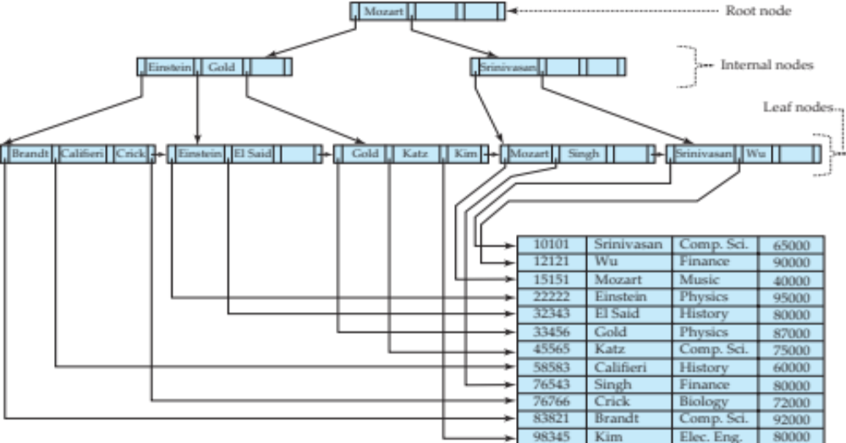
B⁺-Tree Index Files (Cont.)
A B⁺-tree is a rooted tree satisfying the following properties:
All paths from root to leaf are of the same length
Each node that is not a root or a leaf has between ⎡n/2⎤ and n children.
A leaf node has between ⎡(n–1)/2⎤ and n–1 values

Slide 27
B⁺-Tree Index Files (Cont.)
A B⁺-tree is a rooted tree satisfying the following properties:
Special cases:
  If the root is not a leaf, it has at least 2 children.
  If the root is a leaf (that is, there are no other nodes in the tree), it can have between 0 and (n–1) values.
Question: Find the minimum and maximum number of search keys in root, leaf and non-leaf nodes in B+ tree index structure with n = 99.

Slide 28
B⁺-Tree Node Structure
Typical node
  K_{i} are the search-key values
  P_{i} are pointers to children (for non-leaf nodes) or pointers to records or buckets of records (for leaf nodes).
The search-keys in a node are ordered K₁ < K₂ < K₃ < . . . < K_{n–1}

Slide 29
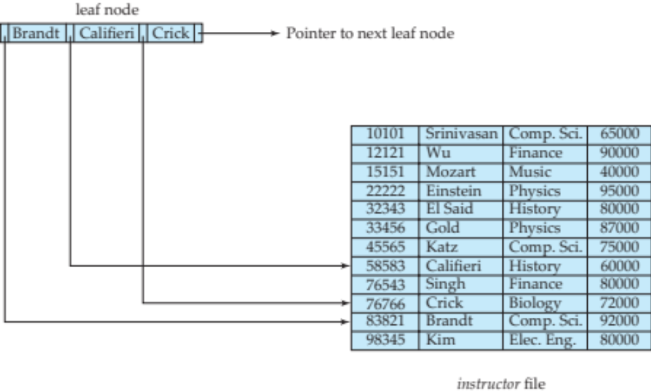
Leaf Nodes in B⁺-Trees
Properties of a leaf node:
For i = 1, 2, . . ., n–1, pointer P_{i} points to a file record with search-key value K_{i},
If L_{i}, L_{j} are leaf nodes and i < j, L_{i}’s search-key values are less than or equal to L_{j}’s search-key values
P_{n} points to next leaf node in search-key order

Slide 30
Non-Leaf Nodes in B⁺-Trees
Non leaf nodes form a multi-level sparse index on the leaf nodes (Explain!). For a non-leaf node with m pointers:
  All the search-keys in the subtree to which P₁ points are less than K₁
  For 2 ≤ i ≤ n – 1, all the search-keys in the subtree to which P_{i} points have values greater than or equal to K_{i–1} and less than K_{i}
  All the search-keys in the subtree to which P_{n} points have values greater than or equal to K_{n–1}
  General structure

Slide 31
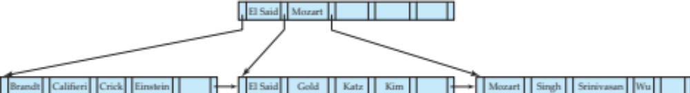
Example of B⁺-tree
B⁺-tree for instructor file (n = 6)
Leaf nodes must have between 3 and 5 values
(⎡(n–1)/2⎤ and n –1, with n = 6).
Non-leaf nodes other than root must have between 3 and 6 children (⎡(n/2⎤ and n with n =6).
Root must have at least 2 children.

Slide 32

Example of B⁺-Tree
Question
Given B+ tree index on name attribute. How the following query will be executed?
Select *
From instructor
Where name = ‘Gold’
Id | Name | Dept. | Salary

Slide 33
Observations about B⁺-trees
The non-leaf levels of the B⁺-tree form a hierarchy of sparse indices.
The B⁺-tree contains a relatively small number of levels
    Level below root has at least 2* ⎡n/2⎤ values (For root, min = 2 child, for child minimum ⎡n/2⎤ child) ….
    Next level has at least 2* ⎡n/2⎤ * ⎡n/2⎤ values
    .. etc.
  If there are K search-key values in the file, the tree height is no more than ⎡ log_{⎡n/2⎤}(K)⎤

